Slide 1

Introducing yourself
practicing
Second section

Slide 2
Hand Shape (individual work)
draw your hands on a paper. Write down 5 things about yourselves to represent:
Something you like
Something you hate
Something you like to share with your colleagues
Something you would like to do I the future
Something of your best skills or traits

Slide 3
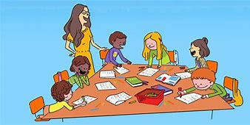

Writing Practice (group work)
*Tell me about yourself
*Write about your favorite hobby.
*Write about your daily routine
*Write about things you can do or you can’t do.

Slide 4

Game: two truths and a lie
Tell us 2 truths about yourself and a lie. We can guess which one is false.

Slide 5
Jobs الوظائف
Judge | قاضى |  | Lawyer | محامى
Politician | سياسي |  | Accountant | محاسب
Mechanic | ميكانيكي |  | Surgeon | جراح
Nurse | ممرضة |  | Composer | مؤلف موسيقى
Guide | مرشد |  | Hunter | صياد
Expert | خبير |  | Cameraman | مصور
Editor | معد |  | Night watchman | حارس ليلي
Manager | مدير |  | Clerk - writer | كاتب
Sailor | بحار |  | Scientist | عالم
Photographer | مصور |  | President | رئيس جمهورية
Diver | غواص |  | Housewife | ربة منزل
Baker | خباز |  | Farmer | فلاح
Artist | فنان |  | Tailor | خياط

Slide 6
Chemist | كيميائي |  | Butcher | جزار
Trader | تاجر |  | Leader | قائد
Cook | طاهي |  | Engineer | مهندس
Greengrocer | بائع خضراوات |  | Hairdresser | مصفف شعر
Policeman | رجل شرطة |  | Professor | أستاذ جامعي
Newsagent | متعهد بيع صحف |  | Grocer | بقال
Historian | مؤرخ |  | explorer | مستكشف
Actor | ممثل |  | Singer | مغنى
Pilot | طيار |  | Waiter | ساقى
barber | حلاق |  | Carpenter | نجار
electrician | كهربائى |  | Soldier | جندى
Officer | ضابط |  | Driver | سائق
Postman | ساعى بريد |  | Receptionist | موظف استقبال
Doctor | طبيب |  | Priest | كاهن
Thief | لص |  | Teacher | مدرس
Jeweler | صائغ |  | Shoemaker | صانع احذية
Poet | شاعر |  | Ambassador | سفير

Slide 7
practice
Let me introduce myself
My name is ………….. I’m a student at ……………
My father is a ……………my mother is a ……………
We live in ……………………
Our family consists of …………. persons
I want to be a ……………………

Slide 8
* On meeting someone you haven’t see for a long time
عند مقابلة شخص لم تراه منذ فترة طويلة
Greeting: Nice to see/meet you again!
I missed you so much.
Reply: Nice to see you, too!
Me, too!

Slide 9
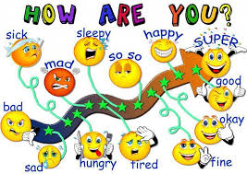
* Asking about health السؤال عن الصحة
How are you?
How is he / she?
Reply: fine, thank you.
Not very well.

Slide 10
The end!

